Slide 1


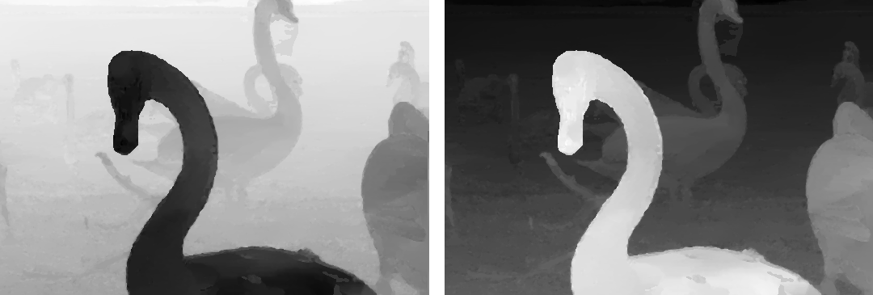
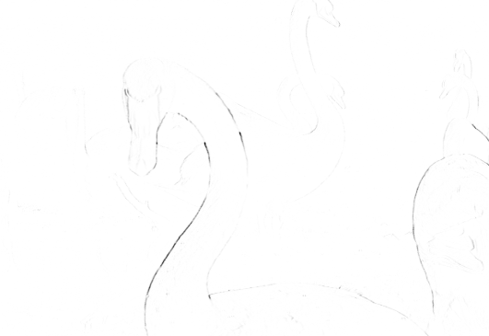
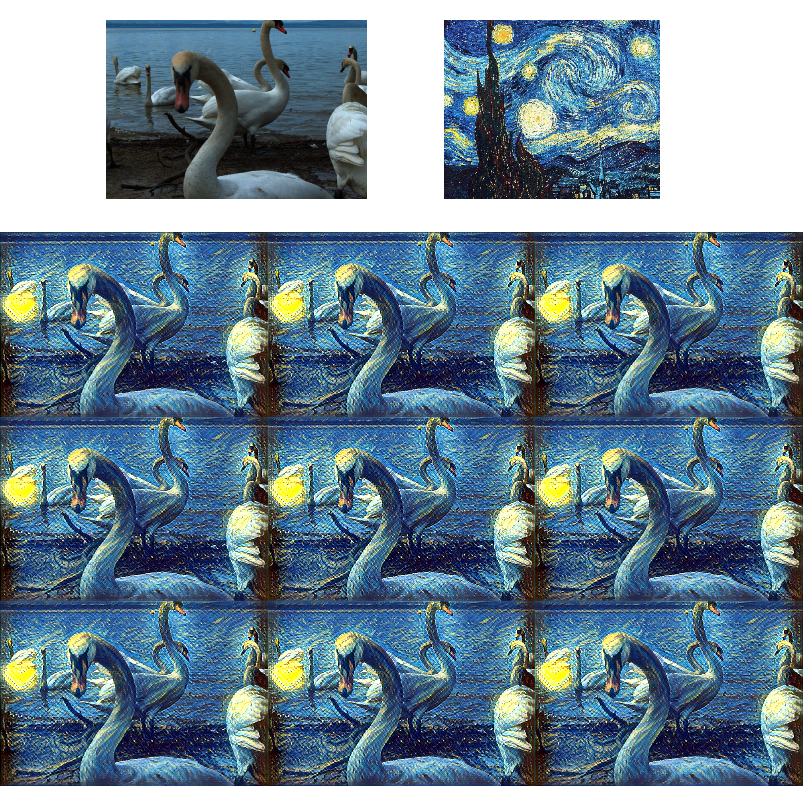
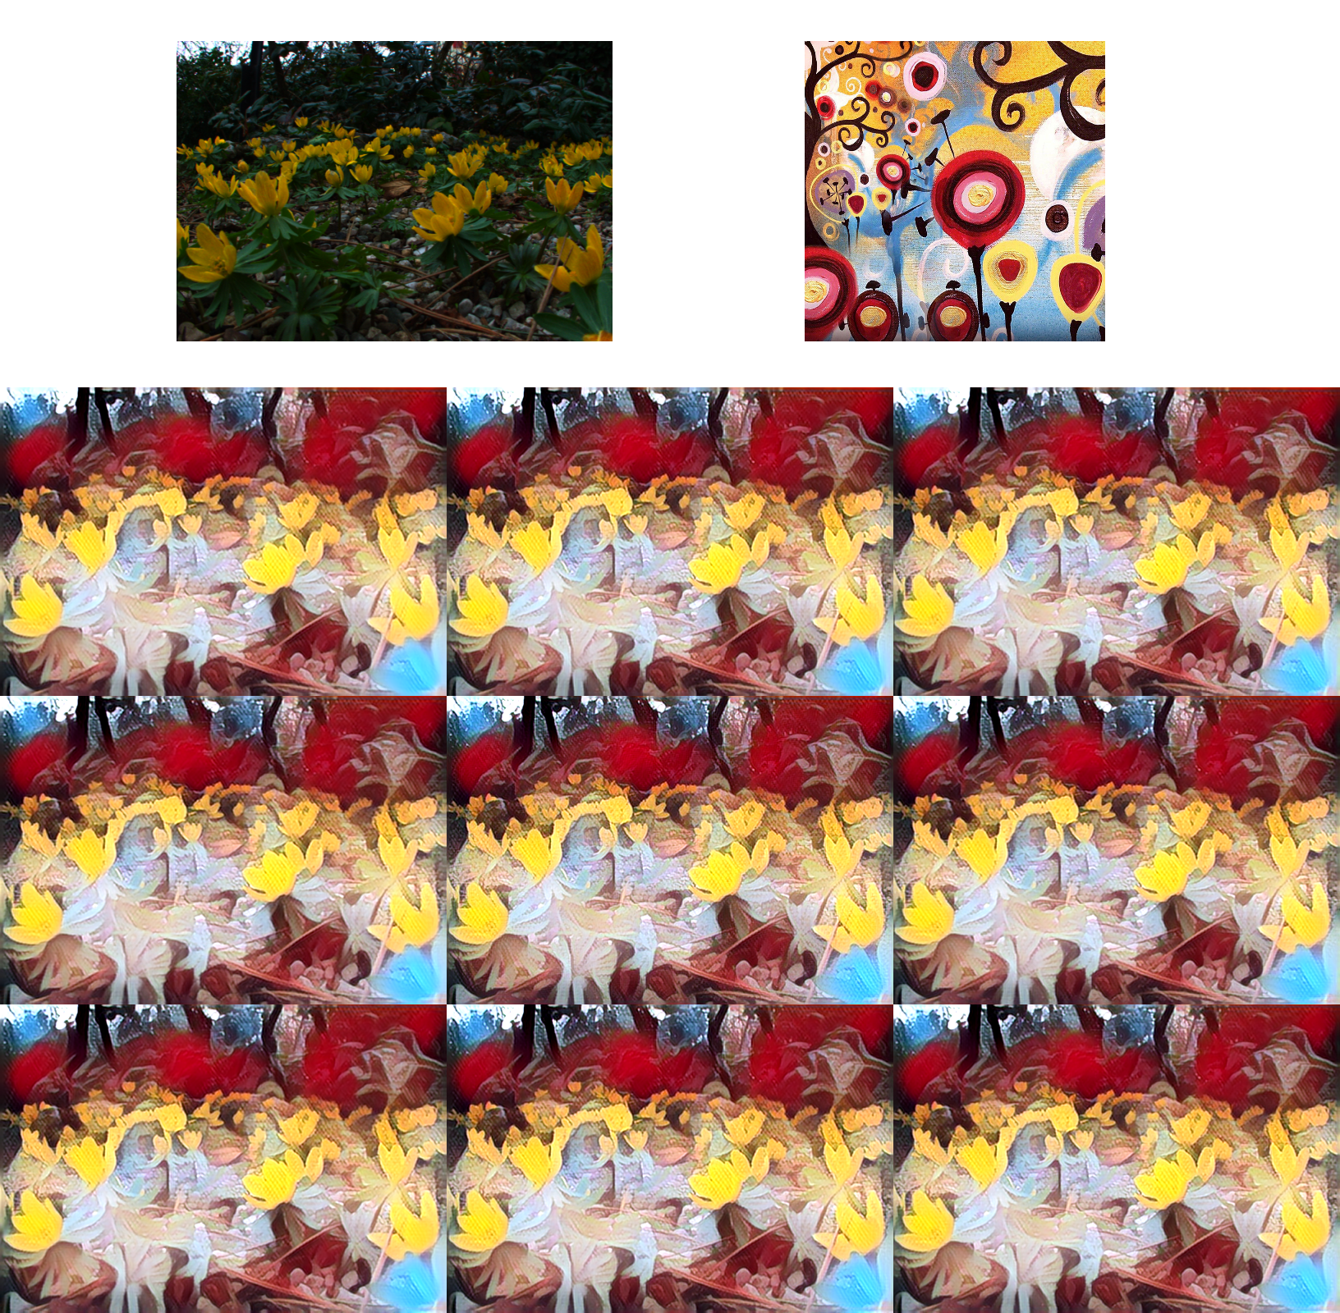
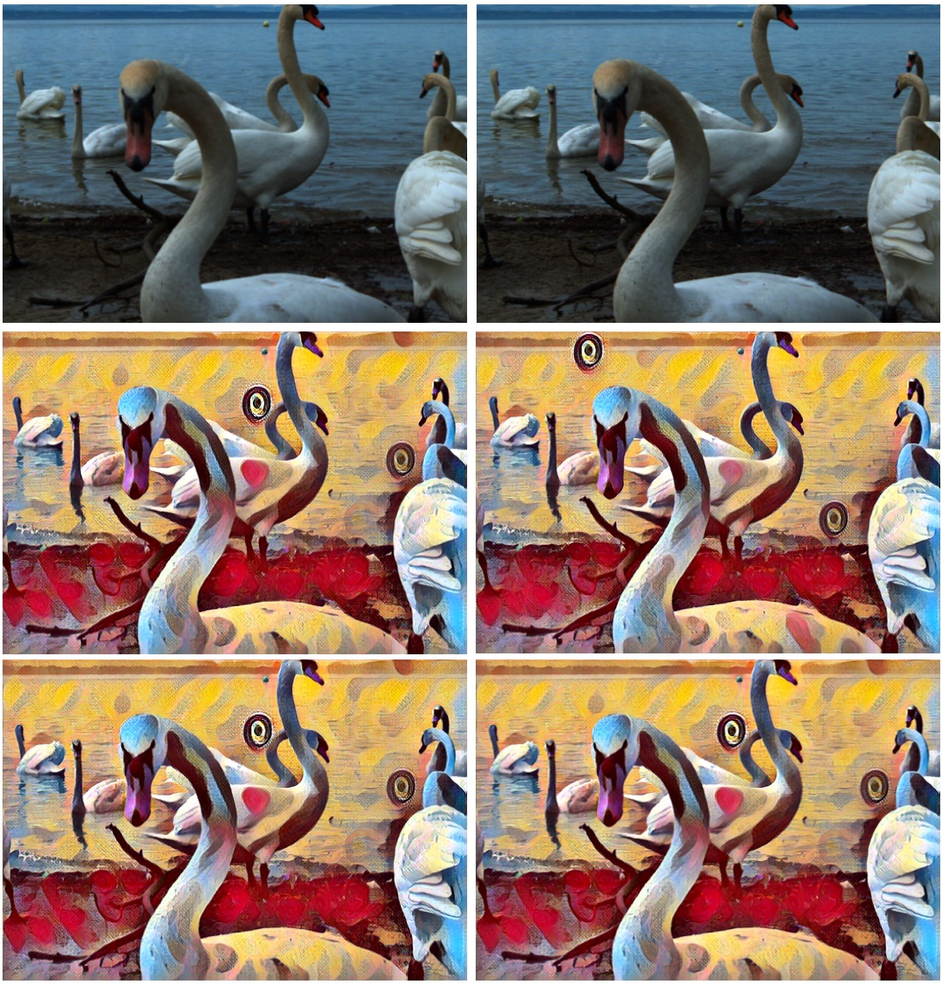
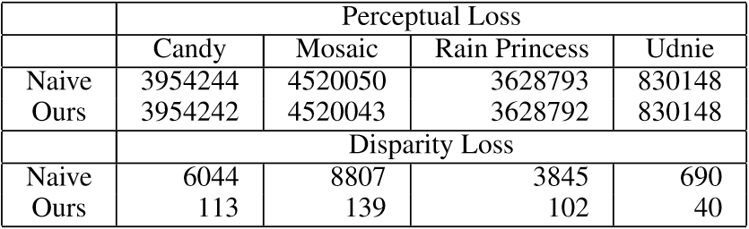
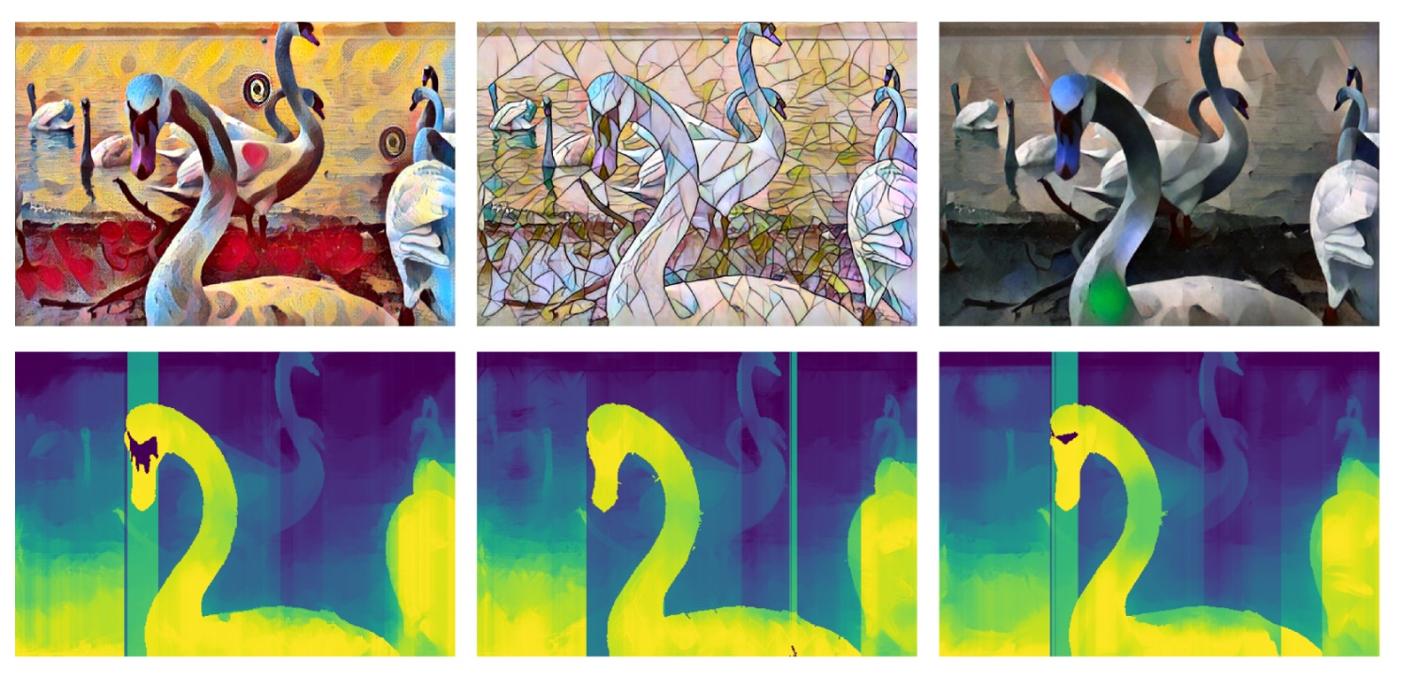
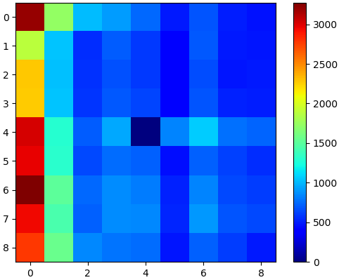
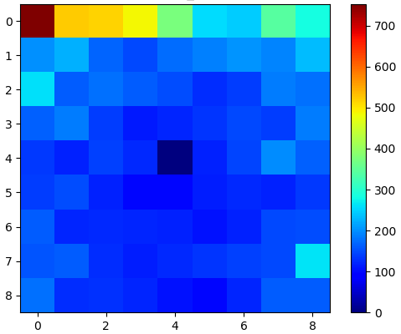




Style Transfer for Light Field Photography
David Hart, Jessica Greenland, Bryan Morse
Brigham Young University
Motivation
Disparity and Consistency Mask
Validation and Results
Is there a way to apply style transfer to an entire light field in an angularly consistent way?
Fig. 2. For each view of the light field, a disparity map and consistency mask relative to the central views. These maps and masks are used to calculate the disparity loss term.
Optimization Process
Fig. 1. Minimal visual differences between two views of a light field result in dramatic differences when stylized naively.
Contributions
An effective method for generating disparity maps for each view in a light field given a single depth image.
A style transfer method for light field photography that does not require a training dataset of light field image.
Fig. 5. Example stylized light fields using our method.
Quantitative Evaluation
Depth Prediction
Fig. 3. Network architecture for neural stylization of light field images. The central view is fed through the pretrained monocular style transfer network. These encoded features and the stylized image that result are held fixed. Each other view is then encoded and its features blended with the central view’s features. The resulting stylized image is then compared with a warped version of the central view and optimized on a disparity loss term.
Background
Visiting Order
Fig. 6. Perceptual and disparity loss values added over and entire light field. Note that our method maintains similar perceptual loss while drastically decreasing disparity loss between views.
Light Fields
Light field cameras allow for effects such as refocusing and novel view generation (Ng 2006).
Like stereo, but with dozens of views
Style Transfer
Groundbreaking work of Gatys et al (2015) and Johnson et al (2016) has reopened this field.
While methods of style transfer exist for video, stereo, and even 360° photography, no method yet exists for light fields.
Fig. 7. Depth prediction from a light field with varying styles.
Refocusing
Fig. 8. Refocusing both the original and stylized light field.
Left Images: Near Focus
Right Images: Far Focus
Fig. 4. Visiting views in scanning order (Left) vs boustrophedonical order (Right) effects the overall disparity loss for each view.

